Slide 1
Steering Committee Meeting
January 30, 2013

Slide 2
Agenda
4:00 | Call to Order & Housekeeping
4:05 | Approval of October 24, 2012 Meeting Summary – ACTION
4:10 | Draft ECOS Plan Review
4:40 | Recommend ECOS Plan to CCRPC and GBIC – ACTION
4:50 | Partner Updates & DOOR PRIZES
5:00 | Adjourn & Celebrate

Slide 3
Call to Order & Housekeeping
Notes:
Thank VEIC!!

Slide 4
Documenting Efforts
• Fill out sign-in sheet
• Record people & hours

Slide 5
Approval of October 24, 2012 Meeting Summary

Slide 6
In the beginning…
We all committed to form a “broadly-based partnership committed to identifying and implementing strategies that improve Chittenden County’s long-term sustainability: economically, environmentally and socially.”

Slide 7
To accomplish the following:
Review, revise and agree on common goal or vision statements by July 2011;
Develop indicators tied to the vision statements to increase accountability and measure progress by March 2012;
Prioritize implementation actions for the next 5, 10 and 20 years that will best further the goals of the Steering Committee by October 2012;
Invest $280,000 of grant funds in high priority implementation actions by January 2013;
Using all of the preceding task results, the responsible organizations will update the Chittenden County Regional Plan, the Chittenden County Metropolitan Transportation Plan, the Chittenden County Comprehensive Economic Development Strategy, and the Burlington Legacy Action Plan in 2013.
Use the results of this process in the updating of our municipal, agency, or organizational plans to the degree appropriate.

Slide 8
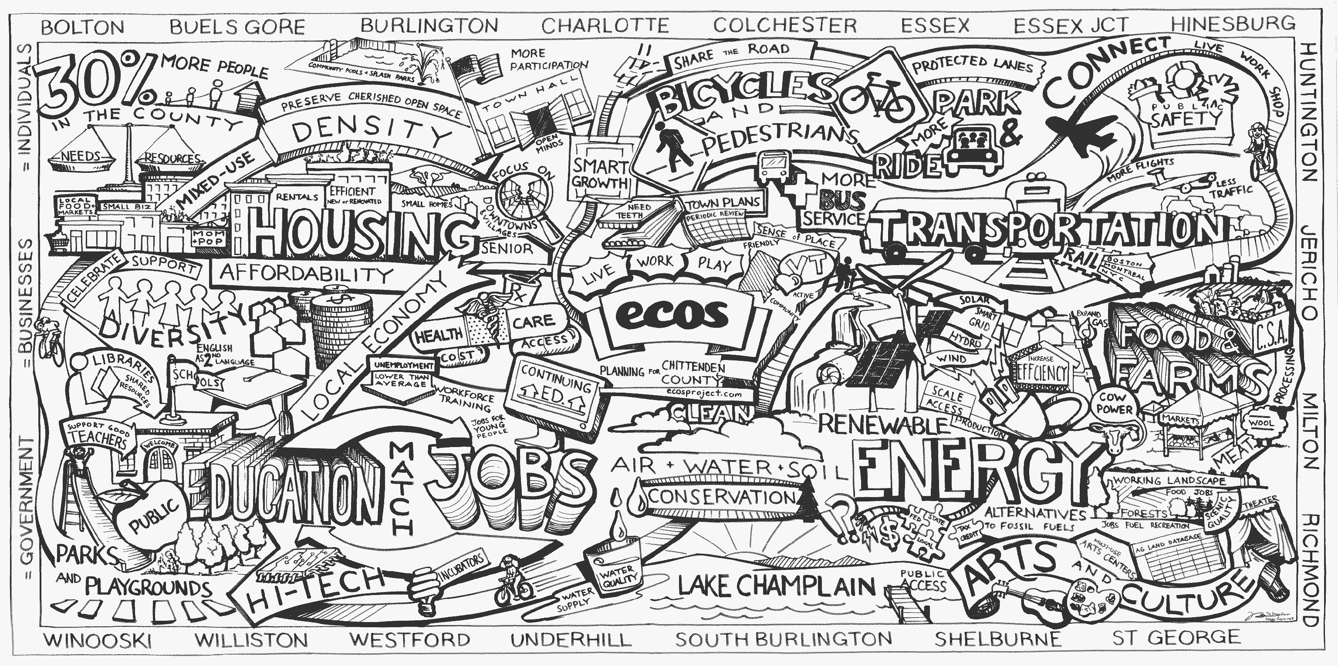
Insert combined mural
Notes:
Artist Matt Heywood compiled all the Ice Cream Social drawings into one.
Exhibit also included Original drawings from the 4 different towns, photos of Dan Higgins, student writing in print and recorded

Slide 9
Draft ECOS Plan

Slide 10
Public Comments
Discussion Draft ECOS Plan was out for public comment from Nov 15 to Dec 31, 2012
Through the website:
200 participants, 130 comments, 2800 votes
Meeting with municipal legislative bodies

Slide 11
Chapter 1 - Introduction
Introduction – 3 Plans in One
Public Process
Vision – Healthy, Inclusive, Prosperous Community
Mission
Principles
Broad Goals

Slide 12
Chapter 2 – Regional Analysis
Regional Context – demographic trends
Natural Systems (ecological systems; scenic/recreational/historic resources; climate change)
Social Community (education/knowledge/skills; health; public safety/criminal justice/hazard mitigation; social connectedness; arts/culture/recreation; civic engagement)
Economic Infrastructure (economy; household financial security; working lands/land-based industries)
Built Environment (land use; housing; transportation; infrastructure/facilities; energy)
The Positives of Now & Concerns for the Future

Slide 13
Chapter 3 - ECOS Plan Priorities
Scenario Planning Review
High Priority Strategies, Actions & Partners
Improve and strengthen the economic systems of our region to increase opportunities for Vermont employers and employees.
Strive for 80% of new development in areas planned for growth, which amounts to 15% of our land area.
Improve the safety, water quality, and habitat of our rivers, streams, wetlands and lakes in each watershed.
Increase investment in and decrease subdivision of working lands and significant habitats, and support local food systems.

Slide 14
Chapter 3 (continued)
Increase opportunity for every person in our community to achieve optimal health and personal safety.
Equip our residents with the education and skills that they need to thrive.
Develop financing and governance systems to make the most efficient use of taxpayer dollars and reduce costs.
Ensure that the projects and actions in all ECOS strategies assess equity impacts, and that the design and development of programs are inclusive of all and engage underrepresented populations.

Slide 15
Online Maps
Maps in Chapter 3 and additional layers
Interactive maps available on display
See Pam Brangan

Slide 16
Sec. 3.3 Annual Reporting
Gain commitment of partners to assist with indicators and accomplishments – to be done
Annual update of indicators – monitor trends
Annual update of progress in implementing projects (accomplishments) – measure performance

Slide 17
Chapter 4
ECOS Regional Plan – planning area map and definition of significant regional impact under review
Comprehensive Economic Development Strategy (CEDS) – project list in Appendix C needs refinement; sector analysis also needs to be included
Metropolitan Transportation Plan (MTP) - including transportation project list, scenario discussion to be updated

Slide 18
Next Steps – ECOS Plan
LRPC meets February 14th to recommend 1st Public Hearing Draft
Mid-February to March 20th public comment period
CCRPC and GBIC Public Hearing March 20th
LRPC meets April 11th to recommend 2nd Public Hearing Draft
Mid-April to May 22nd public comment period
CCRPC and GBIC hold Public Hearing May 22nd
June 19th CCRPC & GBIC/CEDS Committee Adopt ECOS Plan
Annual Indicator & Progress Report/Event?

Slide 19
Proposed Motion
Recommend the ECOS Plan (Chapters 1 to 3), as amended here today, to the CCRPC & GBIC Boards for their review and consideration.
Discussion
Amendments
Vote

Slide 20
Partner Announcements
COLLECTIVE IMPACT EFFORTS:
Partnership for Change, Community Learning Conversation, Saturday, 2/2, 9:30-1:00 @ BHS
Tony Wagner's TED talk
Others?

Slide 21
Door Prize Drawings
Organic Cotton T-Shirt from VNRC (2)
1-Year Membership to VNRC w/Subscription to the Vermont Environmental Report
Bike Rental Gift Certificate from Local Motion
$50 Gift Certificate Towards any Adult Class or Youth Camp at Burlington City Arts

Slide 22
Thank You
ADJOURNMENT

Slide 23
For More Info:
Visit ecosproject.com
Regina Mahony • rmahony@ccrpcvt.org • 802.846.4490 ext.28
Charlie Baker • cbaker@ccrpcvt.org • 802.846.4490 ext.23
THANK YOU!
The work that provided the basis for this publication was supported by funding under an award with the U.S. Department of Housing and Urban Development. The substance and findings of the work are dedicated to the public. The author and publisher are solely responsible for the accuracy of the statements and interpretations contained in this publication. Such interpretations do not necessarily reflect the views of the Government.

